Slide 1
11
Fundamentals of the Nervous System and Nervous Tissue: Part B

Slide 2
Membrane Potentials
Neurons are highly excitable
Respond to adequate stimulus by generating an action potential (nerve impulse)
Impulse is always the same regardless of stimulus

Slide 3
Basic Principles of Plectricity
Opposite charges attract each other
Energy is required to separate opposite charges across a membrane
Energy is liberated when the charges move toward one another
If opposite charges are separated, the system has potential energy

Slide 4
Definitions
Voltage is a measure of potential energy generated by separated charge
  Measured between two points in Volts (V) or Millivolts (mV)
  Called potential difference or potential
    Remember the charge difference (potential) across plasma membranes!
  Greater charge difference between points = higher voltage
Current is flow of electrical charge (Ions) between two points
  Can be used to do work
Resistance is hindrance to charge flow
  Insulator – substance with high electrical resistance
  Conductor – substance with low electrical resistance

Slide 5
Ohm's Law
Gives relationship of voltage, current, resistance
Current (I) = voltage (V) / resistance (R)
Hence:
Current is directly proportional to voltage
No net current flow between points with same potential
Current inversely related to resistance

Slide 6
Role of Membrane Ion Channels
Large proteins serve as selective membrane ion channels
Two main types of ion channels
  Leakage (nongated) channels
    Always open
  Gated
    Part of protein changes shape to open/close channel

Slide 7
Role of Membrane Ion Channels:
Gated Channels
Three types
  Chemically gated (ligand-gated) channels
    Open with binding of a specific neurotransmitter
  Voltage-gated channels
    Open and close in response to changes in membrane potential
  Mechanically gated channels
    Open and close in response to physical deformation of receptors, as in sensory receptors

Slide 8
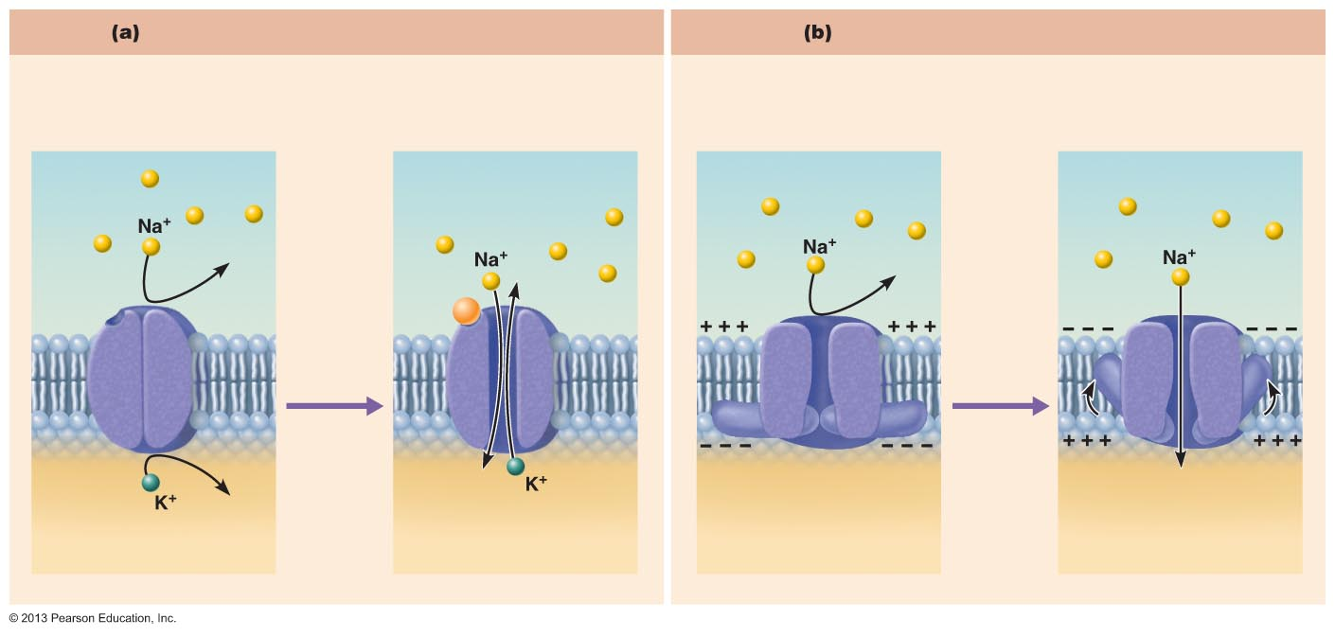
Figure 11.6 Operation of gated channels.
Chemically gated ion channels
Voltage-gated ion channels
Open in response to binding of the
appropriate neurotransmitter
Open in response to changes
in membrane potential
Receptor
Neurotransmitter chemical
attached to receptor
Chemical
binds
Membrane
voltage
changes
Closed
Open
Closed
Open

Slide 9
Gated Channels
When gated channels are open
  Ions diffuse quickly across membrane along electrochemical gradients
    Along chemical concentration gradients from higher concentration to lower concentration
    Along electrical gradients toward opposite electrical charge
  Ion flow creates an electrical current and voltage changes across membrane

Slide 10
The Resting Membrane Potential
Potential difference across membrane of resting cell
  Approximately –70 mV in neurons (cytoplasmic side of membrane negatively charged relative to outside)
    Actual voltage difference varies from -40 mV to -90 mV
  Membrane termed polarized
Generated by:
  Differences in ionic makeup of ICF and ECF
  Differential permeability of the plasma membrane

Slide 11
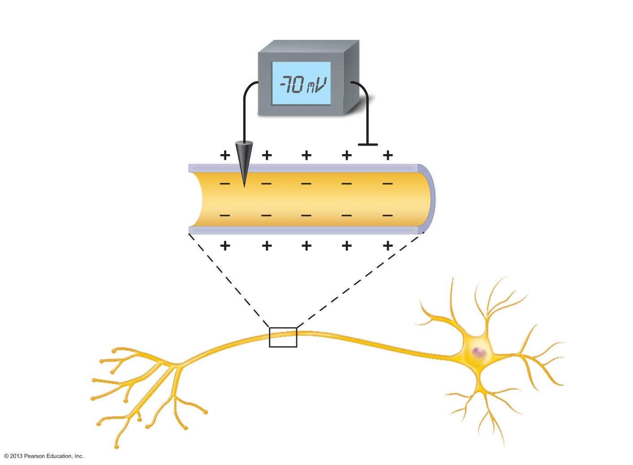
Figure 11.7 Measuring membrane potential in neurons.
Voltmeter
Plasma
membrane
Ground electrode
outside cell
Microelectrode
inside cell
Axon
Neuron

Slide 12
Resting Membrane Potential:
Differences in Ionic Composition
ECF has higher concentration of Na⁺ than ICF
  Balanced chiefly by chloride ions (Cl⁻)
ICF has higher concentration of K⁺ than ECF
  Balanced by negatively charged proteins
K⁺ plays most important role in membrane potential
PLAY
A&P Flix™: Resting Membrane Potential

Slide 13
Differences in Plasma Membrane Permeability
Impermeable to large anionic proteins
Slightly permeable to Na⁺ (through leakage channels)
  Sodium diffuses into cell down concentration gradient
25 times more permeable to K⁺ than sodium (more leakage channels)
  Potassium diffuses out of cell down concentration gradient
Quite permeable to Cl–

Slide 14
Resting Membrane Potential
More potassium diffuses out than sodium diffuses in
  Cell more negative inside
  Establishes resting membrane potential
Sodium-potassium pump stabilizes resting membrane potential
  Maintains concentration gradients for Na⁺ and K⁺
  3 Na⁺ pumped out of cell; two K⁺ pumped in

Slide 15
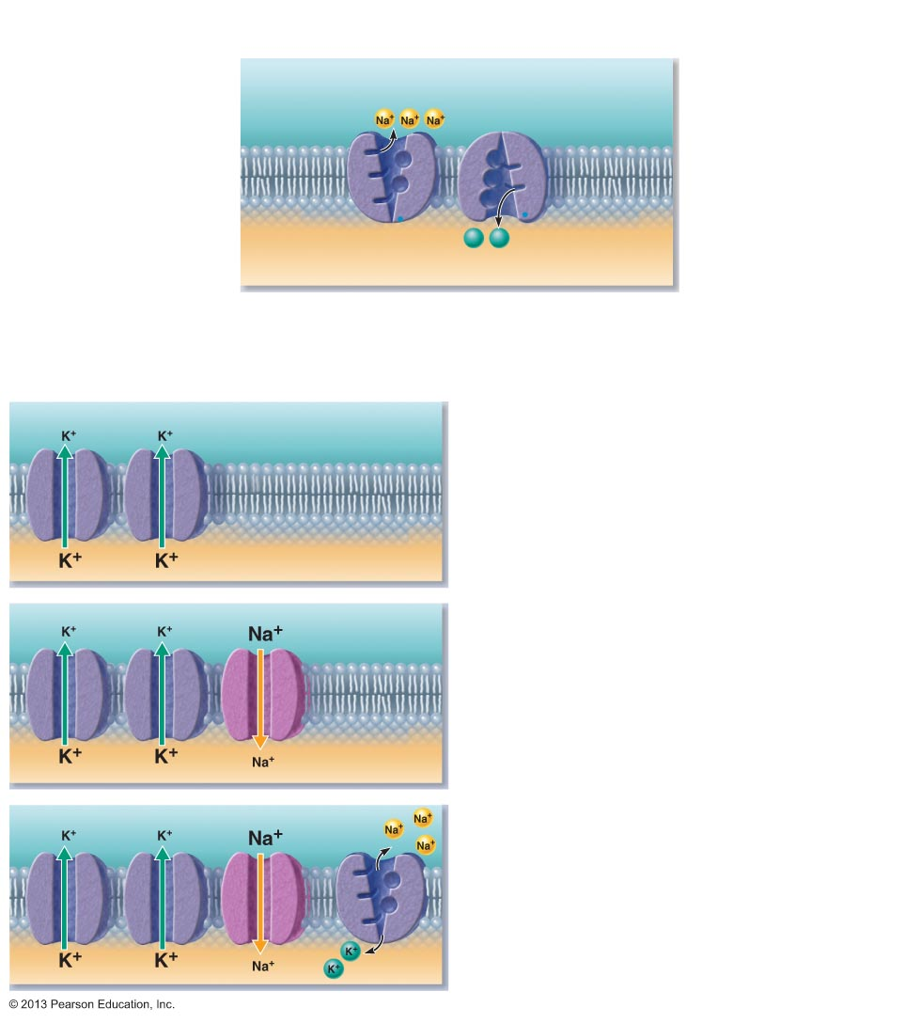
Figure 11.8 Generating a resting membrane potential depends on (1) differences in K⁺ and Na⁺ concentrations inside and outside cells, and (2) differences in permeability of the plasma membrane to these ions.
The concentrations of Na⁺ and K⁺ on each side of the membrane are different.
The Na⁺ concentration
is higher outside the
cell.
Outside cell
K⁺
(5 mM)
Na⁺
(140 mM)
The K⁺ concentration is
higher inside the cell.
K⁺
(140 mM)
Na⁺
(15 mM)
K⁺
K⁺
Na+-K+ pumps maintain
the concentration
gradients of Na+ and K+
across the membrane.
Inside cell
The permeabilities of Na⁺ and K⁺ across the
membrane are different.
K⁺ leakage channels
Suppose a cell has only K⁺ channels...
K⁺ loss through abundant leakage
channels establishes a negative
membrane potential.
Cell interior
–90 mV
Now, let’s add some Na⁺ channels to our cell...
Na⁺ entry through leakage channels reduces
the negative membrane potential slightly.
Cell interior
–70 mV
Na⁺-K⁺ pump
Finally, let’s add a pump to compensate
for leaking ions.
Na⁺-K⁺ ATPases (Pumps) maintain the
concentration gradients, resulting in the
resting membrane potential.
Cell interior
–70 mV

Slide 16
Membrane Potential Changes
Used as Communication Signals
Membrane potential changes when
  Concentrations of ions across membrane change
  Membrane permeability to ions changes
Changes produce two types signals
  Graded potentials
    Incoming signals operating over short distances
  Action potentials
    Long-distance signals of axons
Changes in membrane potential used as signals to receive, integrate, and send information

Slide 17
Changes in Membrane Potential
Terms describing membrane potential changes relative to resting membrane potential
Depolarization
  Decrease in membrane potential (toward zero and above)
  Inside of membrane becomes less negative than resting membrane potential
  Increases probability of producing a nerve impulse

Slide 18
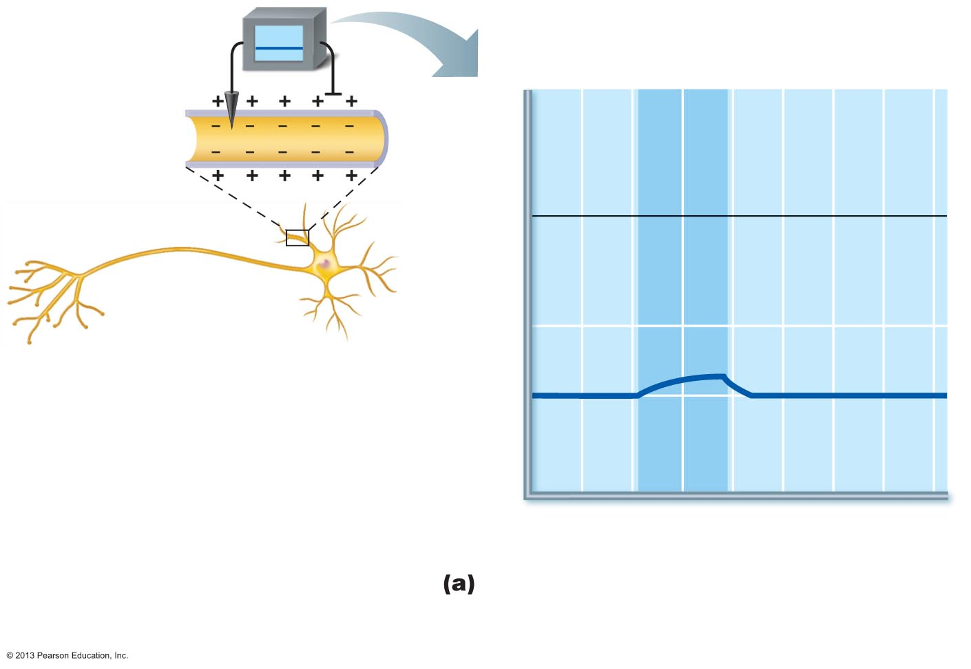
Figure 11.9a Depolarization and hyperpolarization of the membrane.
Depolarizing stimulus
+50
Inside
positive
0
Inside
negative
Membrane potential (voltage, mV)
–50
Depolarization
–70
Resting
potential
–100
0
1
2
3
4
5
6
7
Time (ms)
Depolarization: The membrane potential
moves toward 0 mV, the inside becoming less
negative (more positive).

Slide 19
Changes in Membrane Potential
Terms describing membrane potential changes relative to resting membrane potential
Hyperpolarization
  An increase in membrane potential (away from zero)
  Inside of cell more negative than resting membrane potential)
  Reduces probability of producing a nerve impulse

Slide 20
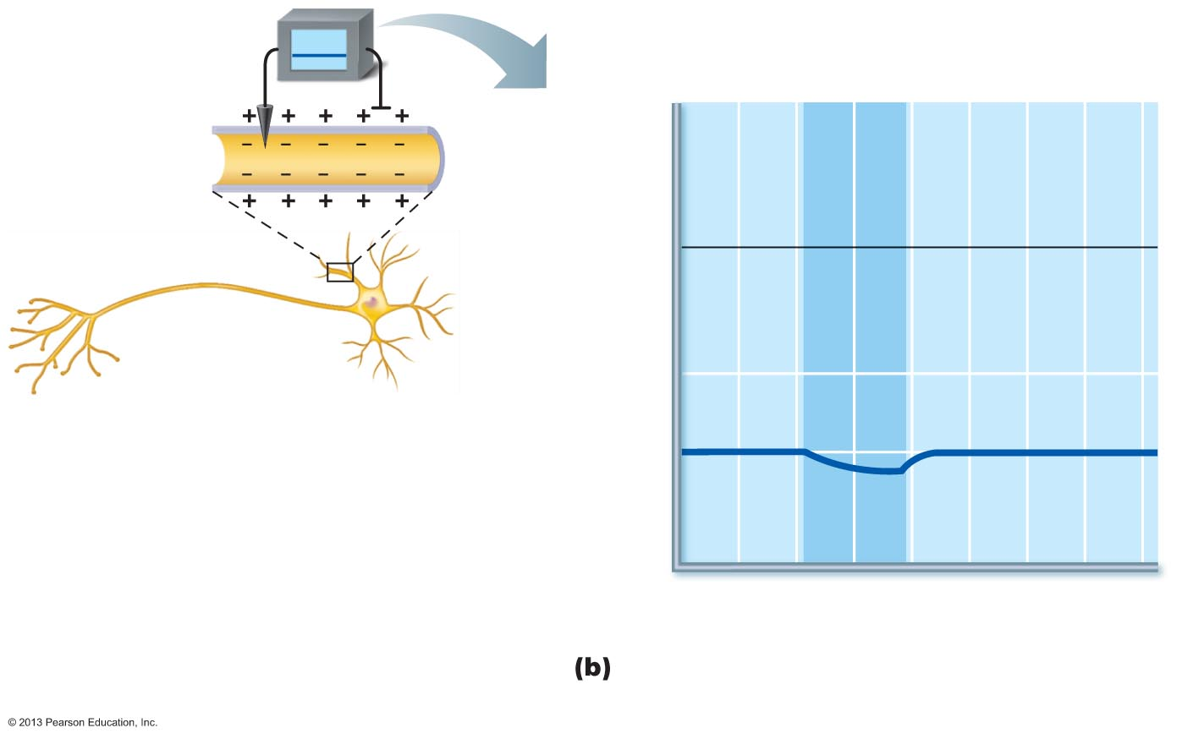
Figure 11.9b Depolarization and hyperpolarization of the membrane.
Hyperpolarizing stimulus
+50
0
Membrane potential (voltage, mV)
–50
Resting
potential
–70
Hyper-
polarization
–100
0
1
2
3
4
5
6
7
Time (ms)
Hyperpolarization: The membrane potential
increases, the inside becoming more negative.

Slide 21
Graded Potentials
Short-lived, localized changes in membrane potential
  Magnitude varies with stimulus strength
  Stronger stimulus → more voltage changes; farther current flows
Either depolarization or hyperpolarization
Triggered by stimulus that opens gated ion channels
Current flows but dissipates quickly and decays
  Graded potentials are signals only over short distances

Slide 22
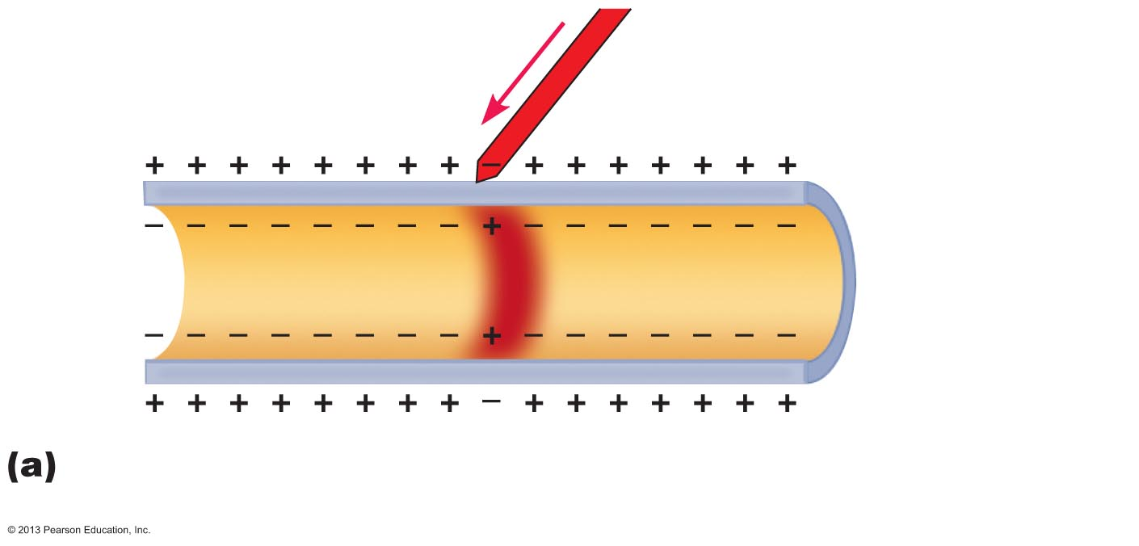
Figure 11.10a The spread and decay of a graded potential.
Stimulus
Depolarized region
Plasma
membrane
Depolarization: A small patch of the membrane (red area)
depolarizes.

Slide 23
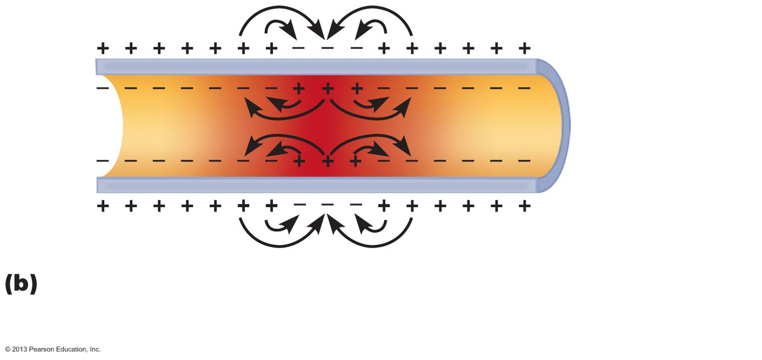
Figure 11.10b The spread and decay of a graded potential.
Depolarization spreads: Opposite charges attract each other.
This creates local currents (black arrows) that depolarize
adjacent membrane areas, spreading the wave of depolarization.

Slide 24
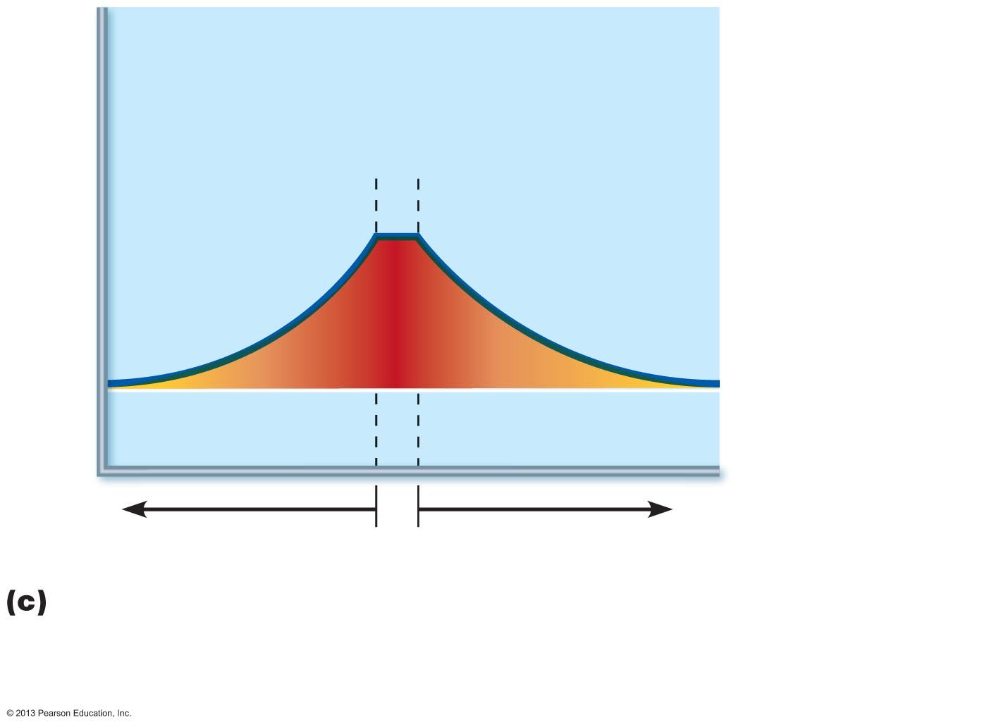
Figure 11.10c The spread and decay of a graded potential.
Active area
(site of initial
depolarization)
Membrane potential (mV)
–70
Resting potential
Distance (a few mm)
Membrane potential decays with distance: Because current is
lost through the “leaky” plasma membrane, the voltage declines with
distance from the stimulus (the voltage is decremental).
Consequently, graded potentials are short-distance signals.

Slide 25
Action Potentials (AP)
Principle way neurons send signals
Principal means of long-distance neural communication
Occur only in muscle cells and axons of neurons
Brief reversal of membrane potential with a change in voltage of ~100 mV
Do not decay over distance as graded potentials do

Slide 26
Properties of Gated Channels
Each Na⁺ channel has two voltage-sensitive gates
  Activation gates
    Closed at rest; open with depolarization allowing Na⁺ to enter cell
  Inactivation gates
    Open at rest; block channel once it is open to prevent more Na⁺ from entering cell

Slide 27
Properties of Gated Channels
Each K⁺ channel has one voltage-sensitive gate
Closed at rest
Opens slowly with depolarization

Slide 28
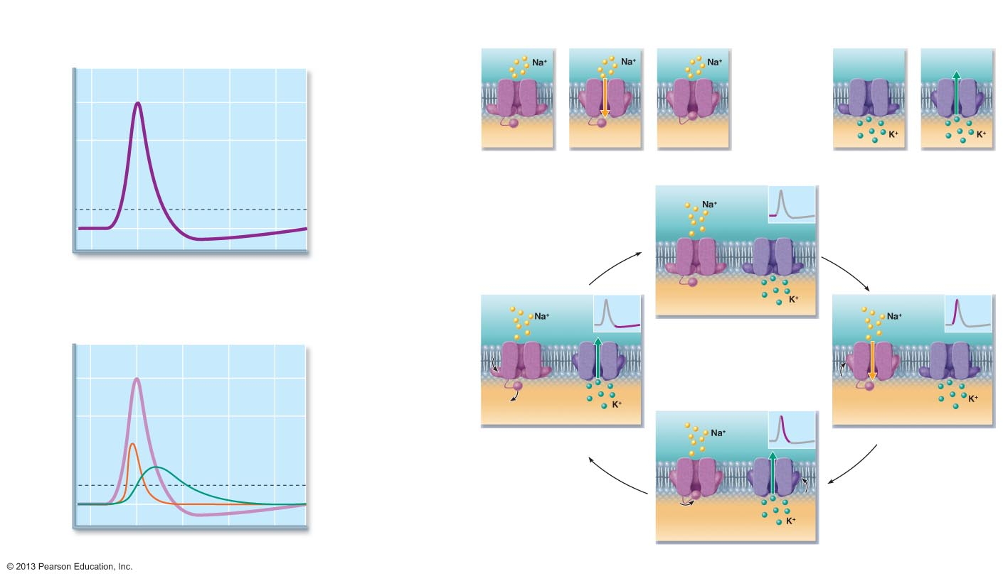
Figure 11.11 The action potential (AP) is a brief change in membrane potential in a “patch” of membrane that is depolarized by local currents.
The big picture
The key players
Resting state
Depolarization
Voltage-gated Na⁺ channels
Voltage-gated K⁺ channels
1
2
Outside
cell
Outside
cell
+30
0
3
3
Repolarization
Inside
cell
Activation
gate
Inactivation
gate
Inside
cell
Membrane potential (mV)
Action
potential
Closed
Opened
Inactivated
Closed
Opened
2
4
Hyperpolarization
Threshold
The events
–55
Sodium
channel
Potassium
channel
–70
1
1
4
0 1 2 3 4
Time (ms)
Activation
gates
The AP is caused by permeability changes in the
plasma membrane:
Inactivation
gate
1
Resting state
+30
3
Action
potential
0
Membrane potential (mV)
2
Na⁺
permeability
Relative membrane
permeability
Hyperpolarization
Depolarization
4
2
K⁺ permeability
–55
–70
1
1
4
0 1 2 3 4
Time (ms)
3
Repolarization

Slide 29
Generation of an Action Potential:
Resting State
All gated Na⁺ and K⁺ channels are closed
Only leakage channels for Na⁺ and K⁺ are open
  This maintains the resting membrane potential

Slide 30
Generation of an Action Potential: Depolarizing Phase
Depolarizing local currents open voltage-gated Na⁺ channels
  Na⁺ rushes into cell
Na⁺ influx causes more depolarization which opens more Na⁺ channels → ICF less negative
At threshold (–55 to –50 mV) positive feedback causes opening of all Na⁺ channels → a reversal of membrane polarity to +30mV
  Spike of action potential

Slide 31
Generation of an Action Potential:
Repolarizing Phase
Repolarizing phase
  Na⁺ channel slow inactivation gates close
  Membrane permeability to Na⁺ declines to resting state
    AP spike stops rising
  Slow voltage-gated K⁺ channels open
    K⁺ exits the cell and internal negativity is restored

Slide 32
Generation of an Action Potential:
Hyperpolarization
Some K⁺ channels remain open, allowing excessive K⁺ efflux
  Inside of membrane more negative than resting state
This causes hyperpolarization of the membrane (slight dip below resting voltage)
Na⁺ channels begin to reset

Slide 33
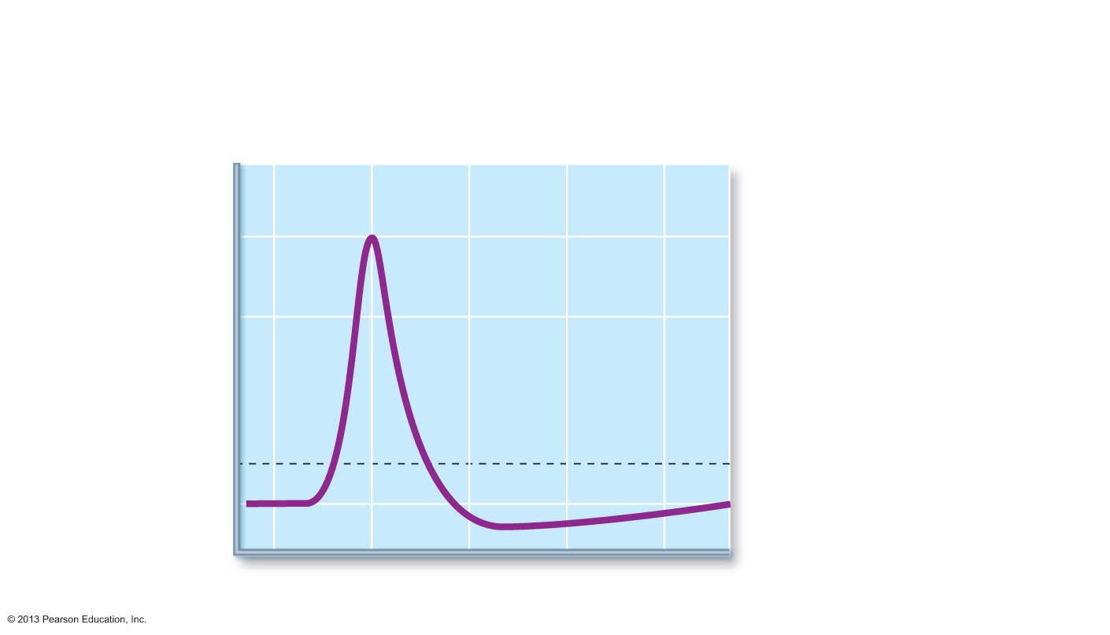
Figure 11.11 The action potential (AP) is a brief change in membrane potential in a “patch” of membrane that is depolarized by local currents. (1 of 3)
1
2
3
Resting state. No
ions move through
voltage-gated
channels.
Depolarization
is caused by Na⁺
flowing into the cell.
Repolarization is
caused by K⁺ flowing
out of the cell.
+30
3
0
4
Hyperpolarization is
caused by K⁺ continuing to
leave the cell.
Membrane potential (mV)
2
Action
potential
–55
Threshold
–70
1
1
4
0
1
2
3
4
Time (ms)

Slide 34
Figure 11.11 The action potential (AP) is a brief change in membrane potential in a “patch” of membrane that is depolarized by local currents. (1 of 3)
1
Resting state. No
ions move through
voltage-gated
channels.
+30
0
Membrane potential (mV)
Action
potential
–55
Threshold
–70
1
1
0
1
2
3
4
Time (ms)

Slide 35
Figure 11.11 The action potential (AP) is a brief change in membrane potential in a “patch” of membrane that is depolarized by local currents. (1 of 3)
1
2
Resting state. No
ions move through
voltage-gated
channels.
Depolarization
is caused by Na⁺
flowing into the cell.
+30
0
Membrane potential (mV)
2
Action
potential
–55
Threshold
–70
1
1
0
1
2
3
4
Time (ms)

Slide 36
Figure 11.11 The action potential (AP) is a brief change in membrane potential in a “patch” of membrane that is depolarized by local currents. (1 of 3)
1
2
3
Resting state. No
ions move through
voltage-gated
channels.
Depolarization
is caused by Na⁺
flowing into the cell.
Repolarization is
caused by K⁺ flowing
out of the cell.
+30
3
0
Membrane potential (mV)
2
Action
potential
–55
Threshold
–70
1
1
0
1
2
3
4
Time (ms)

Slide 37
Figure 11.11 The action potential (AP) is a brief change in membrane potential in a “patch” of membrane that is depolarized by local currents. (1 of 3)
1
2
3
Resting state. No
ions move through
voltage-gated
channels.
Depolarization
is caused by Na⁺
flowing into the cell.
Repolarization is
caused by K⁺ flowing
out of the cell.
+30
3
0
4
Hyperpolarization is
caused by K⁺ continuing to
leave the cell.
Membrane potential (mV)
2
Action
potential
–55
Threshold
–70
1
1
4
0
1
2
3
4
Time (ms)

Slide 38
PLAY
A&P Flix™: Generation of an Action Potential

Slide 39
Role of the Sodium-Potassium Pump
Repolarization resets electrical conditions, not ionic conditions
After repolarization Na⁺/K⁺ pumps (thousands of them in an axon) restore ionic conditions

Slide 40
Threshold
Not all depolarization events produce APs
For axon to "fire", depolarization must reach threshold
  That voltage at which the AP is triggered
At threshold:
  Membrane has been depolarized by 15 to 20 mV
  Na⁺ permeability increases
  Na⁺ influx exceeds K⁺ efflux
  The positive feedback cycle begins

Slide 41
The All-or-None Phenomenon
An AP either happens completely, or it does not happen at all

Slide 42
Propagation of an Action Potential
Propagation allow AP to serve as a signaling device
Na⁺ influx causes local currents
  Local currents cause depolarization of adjacent membrane areas in direction away from AP origin (toward axon's terminals)
  Local currents trigger an AP there
  This causes the AP to propagate AWAY from the AP origin
Since Na⁺ channels closer to AP origin are inactivated no new AP is generated there

Slide 43
Propagation of an Action Potential
Once initiated an AP is self-propagating
  In nonmyelinated axons each successive segment of membrane depolarizes, then repolarizes
  Propagation in myelinated axons differs

Slide 44
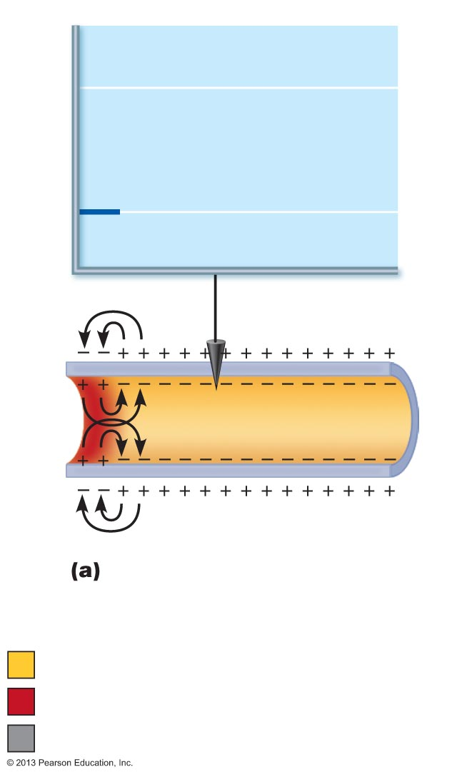
Figure 11.12a Propagation of an action potential (AP).
+30
Voltage
at 0 ms
Membrane potential (mV)
–70
Recording
electrode
Time = 0 ms. Action potential has
not yet reached the recording
electrode.
Resting potential
Peak of action potential
Hyperpolarization

Slide 45
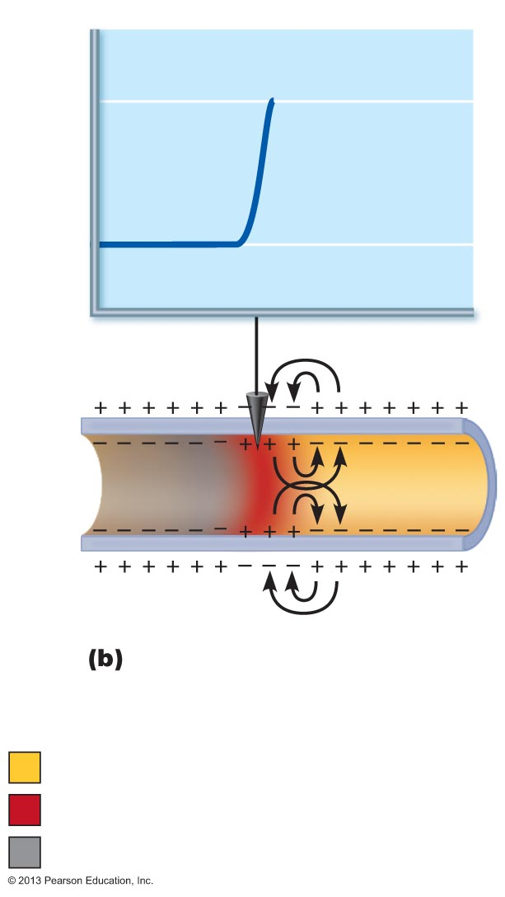
Figure 11.12b Propagation of an action potential (AP).
Voltage
at 2 ms
+30
Membrane potential (mV)
–70
Time = 2 ms. Action potential
peak reaches the recording
electrode.
Resting potential
Peak of action potential
Hyperpolarization

Slide 46
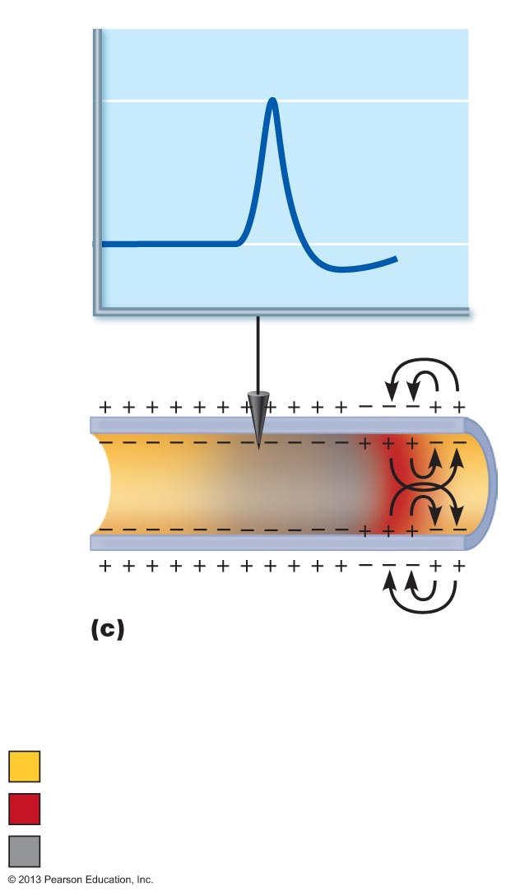
Figure 11.12c Propagation of an action potential (AP).
+30
Membrane potential (mV)
Voltage
at 4 ms
–70
Time = 4 ms. Action potential
peak has passed the recording
electrode. Membrane at the
recording electrode is still
hyperpolarized.
Resting potential
Peak of action potential
Hyperpolarization

Slide 47
PLAY
A&P Flix™: Propagation of an Action Potential

Slide 48
Coding for Stimulus Intensity
All action potentials are alike and are independent of stimulus intensity
  How does CNS tell difference between a weak stimulus and a strong one?
Strong stimuli cause action potentials to occur more frequently
  # Of impulses per second or frequency of APs
CNS determines stimulus intensity by the frequency of impulses
  Higher frequency means stronger stimulus

Slide 49
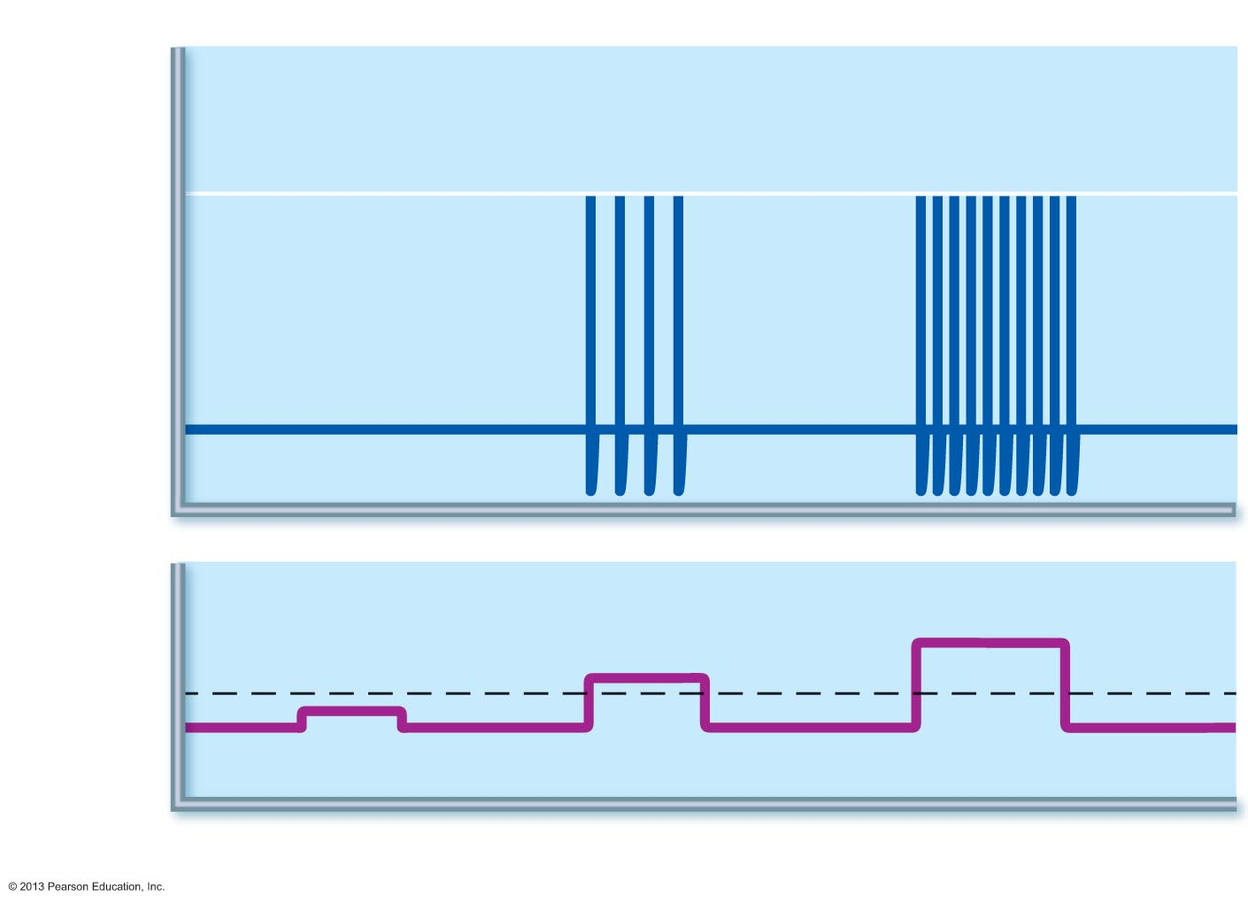
Figure 11.13 Relationship between stimulus strength and action potential frequency.
Action
potentials
+30
Membrane potential (mV)
–70
Stimulus
Threshold
Stimulus
voltage
0
Time (ms)

Slide 50
Absolute Refractory Period
When voltage-gated Na⁺ channels open neuron cannot respond to another stimulus
Absolute refractory period
  Time from opening of Na⁺ channels until resetting of the channels
  Ensures that each AP is an all-or-none event
  Enforces one-way transmission of nerve impulses

Slide 51
Relative Refractory Period
Follows absolute refractory period
  Most Na⁺ channels have returned to their resting state
  Some K⁺ channels still open
  Repolarization is occurring
Threshold for AP generation is elevated
  Inside of membrane more negative than resting state
Only exceptionally strong stimulus could stimulate an AP

Slide 52
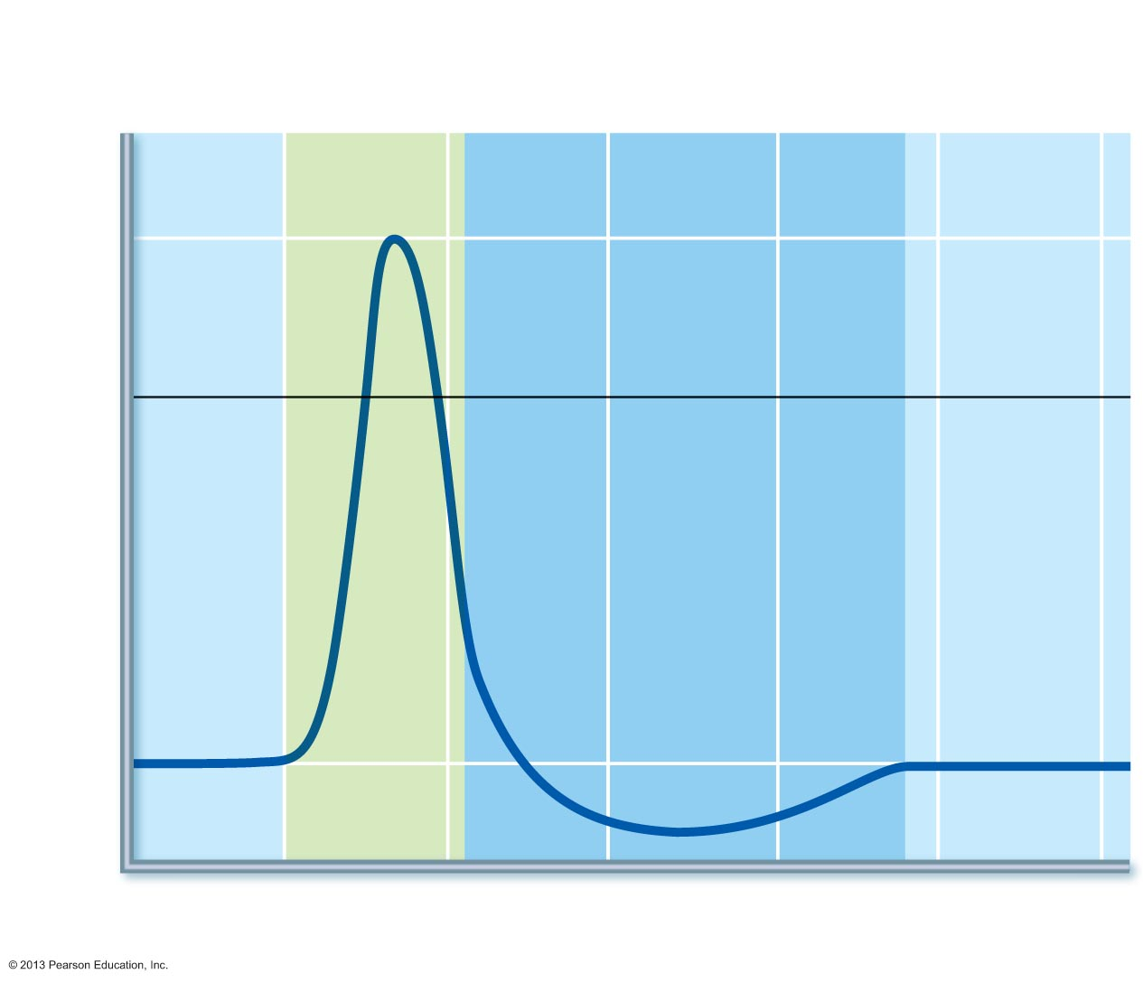
Figure 11.14 Absolute and relative refractory periods in an AP.
Absolute refractory
period
Relative refractory
period
Depolarization
(Na⁺ enters)
+30
0
Membrane potential (mV)
Repolarization
(K⁺ leaves)
Hyperpolarization
–70
Stimulus
0
1
2
3
4
5
Time (ms)

Slide 53
Conduction Velocity
Conduction velocities of neurons vary widely
Rate of AP propagation depends on
  Axon diameter
    Larger diameter fibers have less resistance to local current flow so faster impulse conduction
  Degree of myelination
    Continuous conduction in nonmyelinated axons is slower than saltatory conduction in myelinated axons

Slide 54
Conduction Velocity:
Effects of Myelination
Myelin sheaths insulate and prevent leakage of charge
Saltatory conduction (possible only in myelinated axons) is about 30 times faster
  Voltage-gated Na⁺ channels are located at myelin sheath gaps
  APs generated only at gaps
  Electrical signal appears to jump rapidly from gap to gap

Slide 55
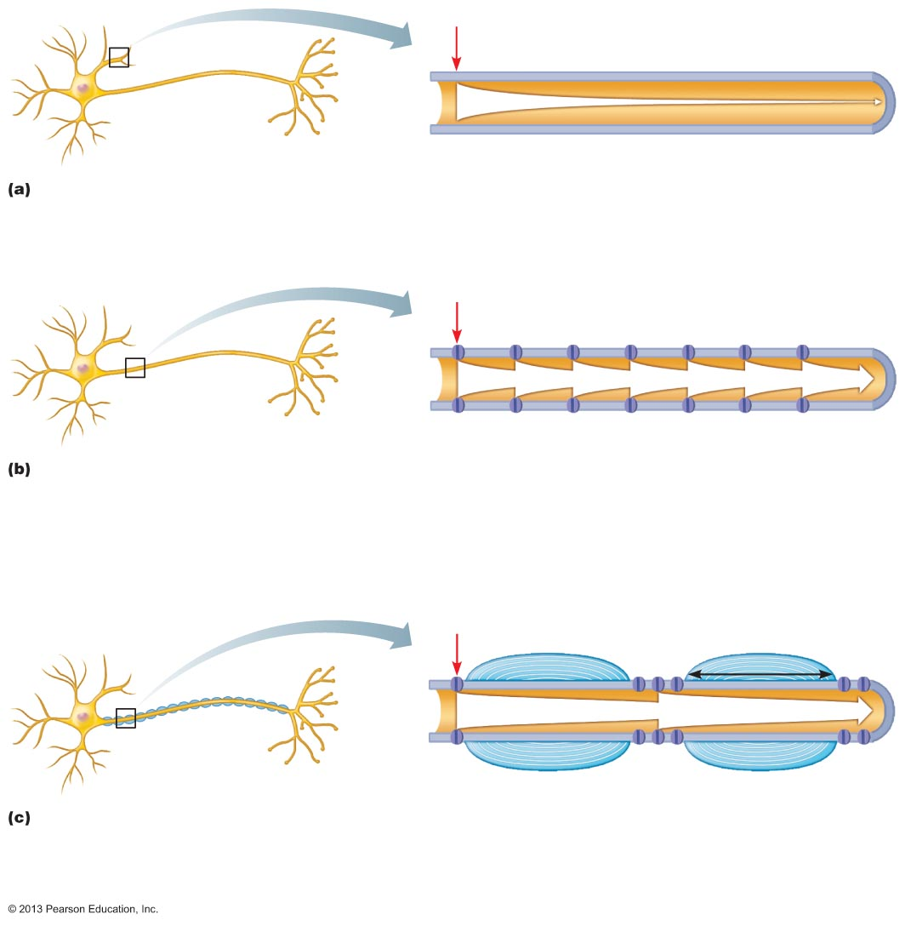
Figure 11.15 Action potential propagation in nonmyelinated and myelinated axons.
Stimulus
Size of voltage
In bare plasma membranes, voltage decays.
Without voltage-gated channels, as on a dendrite,
voltage decays because current leaks across the
membrane.
Stimulus
Voltage-gated
ion channel
In nonmyelinated axons, conduction is slow
(continuous conduction). Voltage-gated Na⁺ and K⁺
channels regenerate the action potential at each point
along the axon, so voltage does not decay. Conduction
is slow because it takes time for ions and for gates of
channel proteins to move, and this must occur before
voltage can be regenerated.
Stimulus
Myelin
sheath
Myelin
sheath gap
Myelin
sheath
1 mm
In myelinated axons, conduction is fast (saltatory
conduction). Myelin keeps current in axons
(voltage doesn’t decay much). APs are generated only
in the myelin sheath gaps and appear to jump rapidly
from gap to gap.

Slide 56
Importance of Myelin Sheaths:
Multiple Sclerosis (MS)
Autoimmune disease affecting primarily young adults
Myelin sheaths in CNS destroyed
  Immune system attacks myelin
    Turns it to hardened lesions called scleroses
  Impulse conduction slows and eventually ceases
  Demyelinated axons increase Na⁺ channels
    Causes cycles of relapse and remission
Symptoms
  Visual disturbances, weakness, loss of muscular control, speech disturbances, and urinary incontinence
Treatment
  Drugs that modify immune system's activity improve lives
Prevention?
  High blood levels of Vitamin D reduce risk of development

Slide 57
Nerve Fiber Classification
Nerve fibers classified according to
  Diameter
  Degree of myelination
  Speed of conduction

Slide 58
Nerve Fiber Classification
Group A fibers
  Large diameter, myelinated somatic sensory and motor fibers of skin, skeletal muscles, joints
  Transmit at 150 m/s
Group B fibers
  Intermediate diameter, lightly myelinated fibers
  Transmit at 15 m/s
Group C fibers
  Smallest diameter, unmyelinated ANS fibers
  Transmit at 1 m/s

